Slide 1
المصطلحات الطبية
Medical terminology is a specialized language used by health care practitioners

Slide 2
4 Parts to a Medical Term
(1) Word Roots = base of a word
Most word roots used as combining forms (e.g. cardiology)
(2) Combining Forms = Word Root & Combining Vowel
Used to connect a word root ---to--- a suffix
Used to connect a word root --- to --- a word root
Rules for use of combining vowels (usually an “O”)
Don’t use when suffix begins with a vowel (e.g. dermat/itis)
Use if suffix begins with a consonant (e.g. rhino/plasty)
Use if connecting a word root to a word root (e.g. gastro/esophageal)
* this makes a COMPOUND WORD
(3) Prefixes = at beginning of word root
(4) Suffixes = at end of word root (usually with combining vowel)
Notes:
Rules on page 4 of text
Use appendix A for prefixes, word roots, and suffixes
Many suffixes mean “pertaining to” ----- see appendix A

Slide 3
Example of medical term;
Myocarditis = muscle layer of heart inflamed
(prefix) (root) (suffix)
myo = muscle card = heart itis = inflammation
Peri = outer layer card itis = inflammation

Slide 4
Prefix change:
hyper = prefix mean excessive
Hypo = prefix mean decrease
Euo = Prefix mean Equal
Suffix change:
Cardiologist = a physician specializing in the heart
Cardiomyopathy = damage
Cardiomegaly = enlargement

Slide 5
Key Vocabulary Terms مصطلحات المفردات الرئيسية
Cyt/o = combining form for cell
Blast/o = immature
Hist/o = tissues
Sinistr/o = left
Dextr/o = right
Ultra- = prefix meaning in excess or beyond
Intra- = within
Contra- = against
Trans- = across
Retro- = behind
Peri- = around
Circum- = around
Dia- = through
Diarrhea = flowing through
Diaphoresis = profuse sweating

Slide 6
Introductory Medical Terms
Anatomy ----------------------- structure of something التشريح
Physiology---------------------- study of function الفسلجة
Etiology -------------------------cause of the disease مسببات المرض
Idiopathic disease------------ disease with unknown cause
Iatrogenic disease-------------disease caused by human intervention
Nosocomial disease ----------disease acquired in a healthcare facility
Congenital diseases --------- diseases occurring at birth
Symptoms of disease --------subjective findings ( patient’s history)
Signs of disease -------------- objective findings (patient’s physical exam)
Syndrome ---------------------common cause of different signs & symptoms

Slide 7
Remission----------------------- period when symptoms of disease abates
Organic versus functional disorders or diseases
Organic disorder------------- physical changes are present
Functional disorder ------no physical changes to explain symptoms
Diagnosis-----------------------nature of the disorder التشخيص
Remember: etiology ----cause of the disorder
Prognosis ---------------------what is in the future for this problem
Eponym----------------------- “named after”
Acronym ---------------------- word formed from initial
letter of major parts of term
LASER = light amplification by stimulated emission of radiation
SCUBA = self contained underwater breathing apparatus
Note: prefix “acro” = extremity, top, extreme
Acrocyanosis = blue discoloration of fingers, toes, nose
Acrophobia
Incubation -------------------latent period of the disease
before develop signs & symptoms

Slide 8
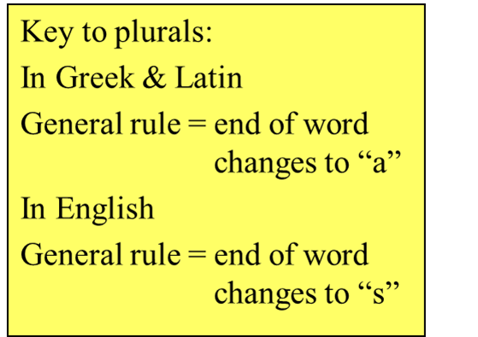
الجمع في المصطلحات الطبية والمختصرات
Pluralizing Terms
And Abbreviations

Slide 9
RULES For pluralization
1. Add (s) to words ending (ex. joint- joints, muscle- muscles)
2. Add (es) to words ending in s,x,y or z
(ex. reflex – reflexes, mass- masses)
3. Remove (x) and add ces. (ex. appendix - appendices)
4. Remove the (`y ) and add (`ies) ex. mastectomy- mastectomies)
5. When an ending (`y ) is preceded by a vowel, the usual plural suffix is (`s) (ex. boy - boys)

Slide 10
6. Add (`e ) to Latin terms ending in( a ) ex. lamina – laminae
Remove (`us ) and add (`i ) to Latin words ending in us.
(ex. bacillus- bacilli, Alveolus ----------alveoli , Nucleus -----------nuclei)
7. Change (`sis ) to (`ses ) in Greek words ending in sis.
(ex. psychosis - psychoses)
8. Remove (`um ) from and add ( `a ) to Latin words ending in (um) (ex. diverticulum - diverticula)

Slide 11
Singular & Plural Endings
Word ends with “a”
Vertebra --------- a to ae ---------------------- just add e
Word ends with “is”
diagnosis --------- diagnoses ------------------------is to es
testis --------------- testes
metastasis ----------metastases
Word ends with “on” or “um” ----------------- just change to “a”
Ganglion --------- ganglia
Ovum-------------- ova
Atrium ------------atria

Slide 12
Singular & Plural Endings
(note: these are listed in alphabetical order)
Words ending in Singular Plural
-a vertebra vertebrae
-ax thorax thoraces
- ex or -ix appendix appendices
apex apices
-is metastasis metastases
diagnosis diagnoses
testis testes
-ma sarcoma sarcomata
-nx phalanx phalanges
-on ganglion ganglia
-us nucleus nuclei
-um ovum ova
-y biopsy biopsies

Slide 13
Levels of Organization
Anatomical Position
Erect
Face forward
Palms forward
Toes directed forward
Arms at sides

Slide 14
Body Directions

Slide 15
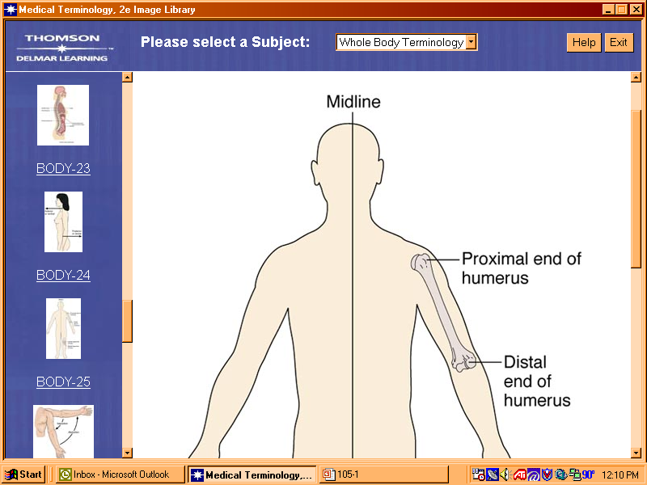
Body Directions proximal/distal lateral /medial cephalic/ caudal superior/ inferior superficial/ deep anterior/ posterior ventral/ dorsal

Slide 16
Body Planes & Sections
Transverse
Horizontal
Gives “cross sections”
Divides body into superior & inferior sections
Sagittal
Vertical (front to back)
Divides body into right & left sections
Midsagittal = get two equal halves
Sagittal = get unequal right & left sides
Frontal
Coronal
Vertical (side to side)
Get anterior & posterior sections

Slide 18
Body Cavities

Slide 19
Movement of Body Parts abduction/adduction flexion/ extension rotation/ circumduction supination/ pronation

Slide 20
Some important abbreviations
Bid twice a day
tid three times a day
tw twice a week
BM bone marrow or bowel movement
BP blood pressure
BPM beats per minute
BW body weight
q4h, q6h.... every 4 hours, every 6 hours etc.
qid four times a day
qod every other day
Rx treatment

Slide 21
CXR chest X-ray
DDx differential diagnosis
DOA dead on arrival
DX diagnosis
ENT ears, nose, and throat
FU follow-up
Fx fracture
Hgb hemoglobin
HR heart rate
HS at bedtime

Slide 22
HSM hepatosplenomegaly
HTN hypertension
Hx history
IM intramuscular
IT interthecal
IV intravenous
KUB kidneys, ureters, bladder
PO by mouth
PR by rectum
Pt patient

Slide 23
Skin: Integument System note integument means covering
Structures
3 layers
Epidermis
Dermis
Subcutaneous layer
Glands
Sweat
Sebaceous
Hair
Hair shaft
Hair follicle

Slide 24
Key System Terminology
Skin -------------------- dermat/o; derm/o; cutane/o
Hair -------------------- trich/o; pil/i; pil/o
Sweat glands --------- hidr/o
Sebaceous gland ----- seb/o
Nails --------------------ungu/o; onchy/o
-itis = inflammation
Acr/o = high, distant, extremity
Megal/o = enlarged
Cyan/o = blue
Eryth/o = red
Melan/o = black
-osis = condition of (melanosis)

